Slide 1

Basket Scanner
Make easy way shop in supermarket
Enrollment No. – 169550307039
Project Guide :- Hiral Ma’am

Slide 2
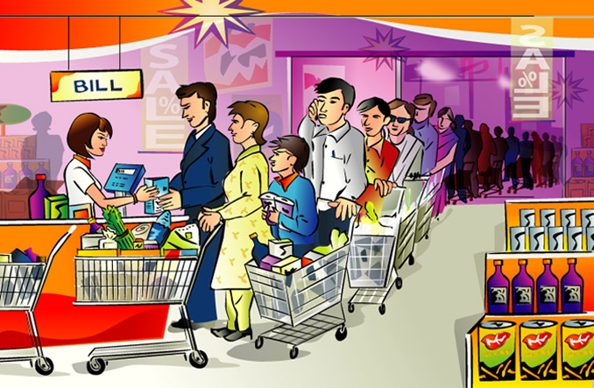
The Basic Problem of supermarket
While purchasing in the supermarket we can gather items(products) we want, put it in the container(Basket, Trolley).
At the time of billing only we come to know about the total cost.
And then we need to stand in a queue for billing those items or Scan that items.

Slide 3
The Purpose of products
This product can save people time for shopping.
This product can easily use for make shopping in mall or supermarket.
This product used for billing section in mall it can make bill faster.

Slide 4
Solution of that problems
To avoid this problem to scan that items by their Basket with basket scanner.
Then We didn’t stand in queue for scanning. We can easily shop and pay the bill.

Slide 5
User Module
Basket Scanner :-
It is use for Scan the products and store that details in database
It can scan by user and put that product in basket.

Slide 6
Admin Module
System :-
It can scan the basket by there barcode.
It can make final bill, or delete any products which are not in basket and update that bill.

Slide 7
Component
Hardware Component :-
POWER SUPPLY (12V TO 5V)
ARDUINO BOARD
WIFI MODEM
RFID READER MODEM AND RFID CARD
Arduino UNO
RESET AND CRYSTAL CIRCUIT
LCD (16 × 2)
LED
Node MCU
Bluetooth Module
Resistor

Slide 8
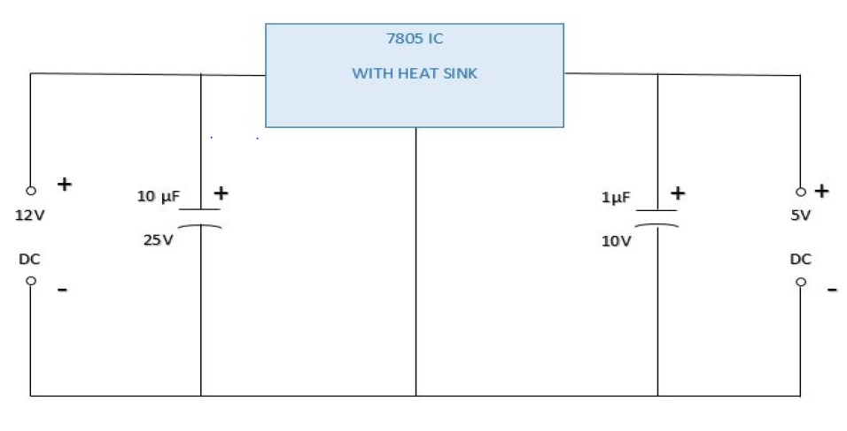
Power Supply (12v to 5v)
This is a circuit of a 12V to 5V Converter using a 7805 regulated IC. The circuit mentioned here is also a step down DC to DC convertor using LM 7805 IC which can provide fixed 5 volt output from any 2V DC. The circuit is ideal to use with a 12V car battery to step down the voltage to 5 volt DC.

Slide 9
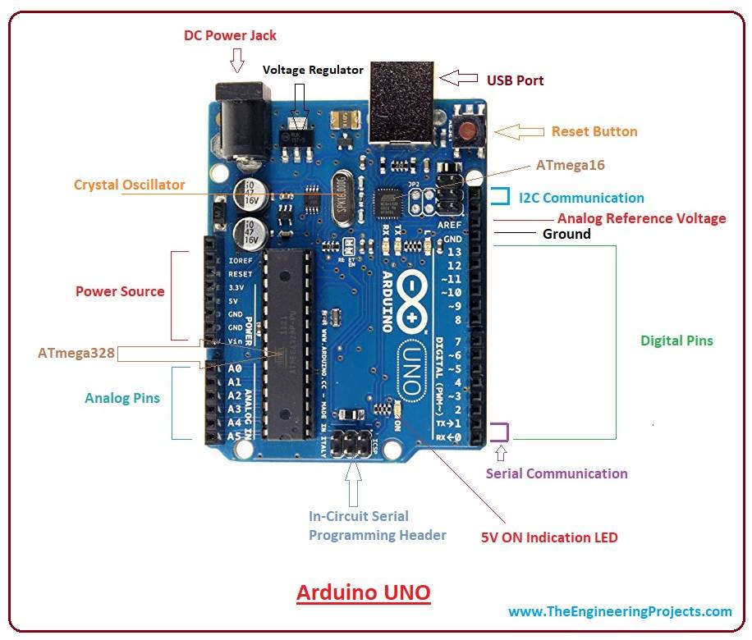
ARDUINO BOARD
The Arduino is the open source microcontroller development board based on the ATMEGA328P microcontroller IC designed to provide the simple and cheap platform to the hobbyists and students for designing their digital and embedded systems projects. The ATMEGA328P microcontroller IC is the heart of the Arduino microcontroller development that is the board is designed around the ATMEGA328P microcontroller IC.

Slide 10
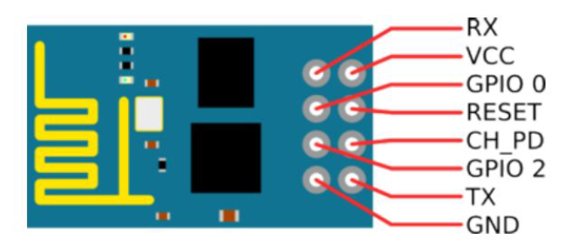
WIFI MODEM
This Module Works On 3.3V Voltage Range. So Make Sure You Do Not Connect More Than 5 Volt With This Module Otherwise Your Module Will Get Damaged. It Works On Serial Communication.
To interface this module with any microcontroller and any digital device we should know about operating voltages of this device and microcontroller.

Slide 11
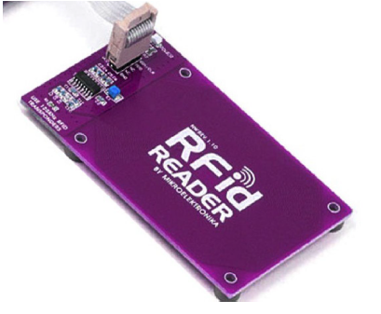
RFID READER MODEM
RFID is an acronym for Radio Frequency Identification - The use of wireless communications to establish the identity of a physical object. RFID term is used to describe a system that transmits the identity of an object wirelessly, using radio waves. A RFID tag is attached to an object and contains information about that object. Data transmitted from the tag can be product, location or any other information. The main popularity of the RFID system was that it has the ability to track moving objects.

Slide 12
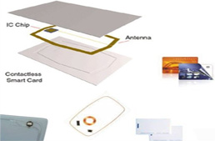
RFID CARD
Tag is made up of an integrated antenna and memory. The information can be written and rewritten on Tag memory. The unique ID written on Tag while manufacturing is known as the EPC (Electronic Product Code). This Tag is enclosed in a Rectangular Plastic Card of the size of Bank Debit / credit card.

Slide 13
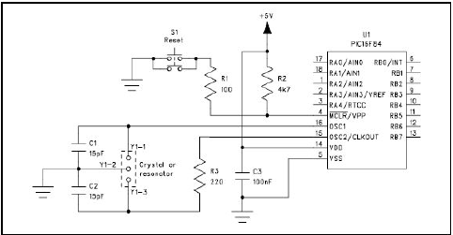
RESET AND CRYSTAL CIRCUIT
The function of an oscillator circuit is to provide an accurate and stable periodic clock signal to a microcontroller. The frequency of this clock signal can range from a few kilohertz to tens of megahertz and determines how quickly the microcontroller executes its instructions. Most microcontrollers include a clock driver circuit which is designed to drive a quartz crystal into oscillation.

Slide 14
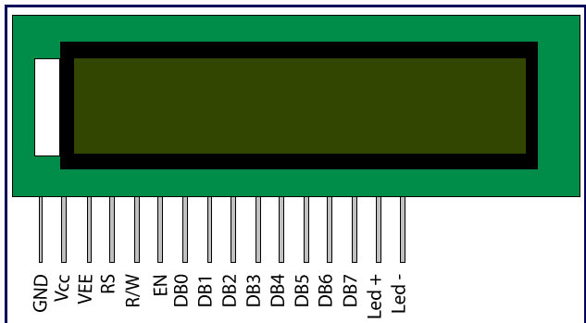
LCD (16 × 2)
16×2 LCD is named so because, it has 16 Columns and 2 Rows. There are a lot of combinations available like 8×1, 8×2, 10×2, and 16×1 etc. But the most used one is the 16×2 LCD. Hence we are using it here All the above mentioned LCD display will have 16 Pins and the programming approach is also the same and hence the choice is left to you.

Slide 15
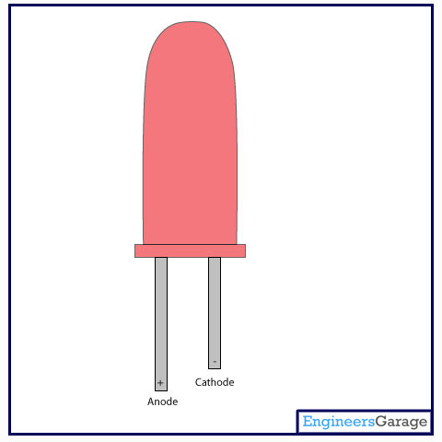
LED
Light emitting diodes (LEDs) are semiconductor light sources. The light emitted from LEDs varies from visible to infrared and ultraviolet regions. They operate on low voltage and power. LEDs are one of the most common electronic components and are mostly used as indicators in circuits. They are also used for luminance and optoelectronic applications.

Slide 16
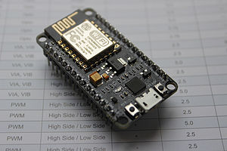
Node MCU
Node MCU is an open source IoT (internet of things) platform. The term "NodeMCU" by default refers to the firmware rather than the development kits. The firmware uses the Lua (Programming Language) scripting language.

Slide 17
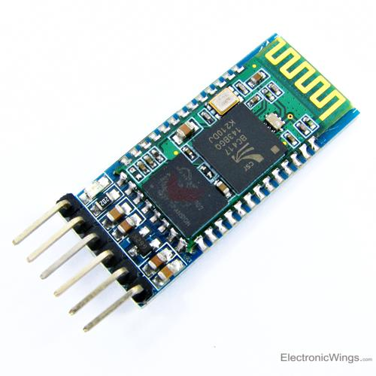
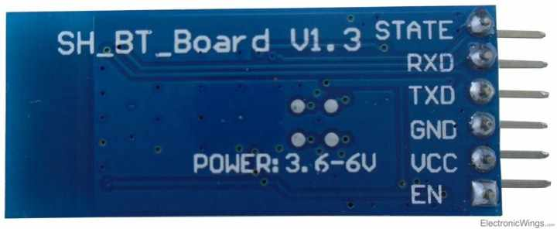
Bluetooth Module
It is used for many applications like wireless headset, game controllers, wireless mouse, wireless keyboard and many more consumer applications. It has range up to <100m which depends upon transmitter and receiver, atmosphere, geographic & urban conditions.

Slide 18
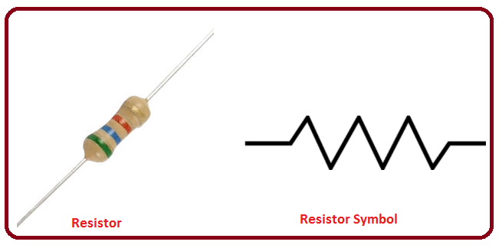
Resistor
Resistor is an electrical component that reduces the electric current. The resistor's ability to reduce the current is called resistance and is measured in units of ohms (symbol: Ω).

Slide 19
Component of software
Android Studio
Android Studio is the official integrated development environment (IDE) for Google Android operating system, built on JetBrains IntelliJ IDEA software and designed specifically for Android development.
Arduino
Arduino is an open-source hardware and software company, project and user community that designs and manufactures single-board microcontrollers and microcontroller kits for building digital devices and interactive objects that can sense and control objects in the physical and digital world.

Slide 20
Advantages :-
It make easy to shop in supermarket and save our time.
We will not stand in queue and make fast the shopping.
We can scan easily products and put in basket.
There are not rush in supermarket for shopping.
All Customer have satisfy.

Slide 21
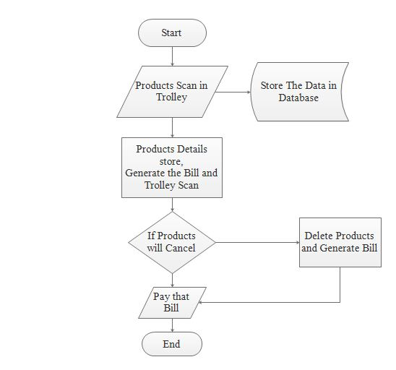
Flow chart :-

Slide 22
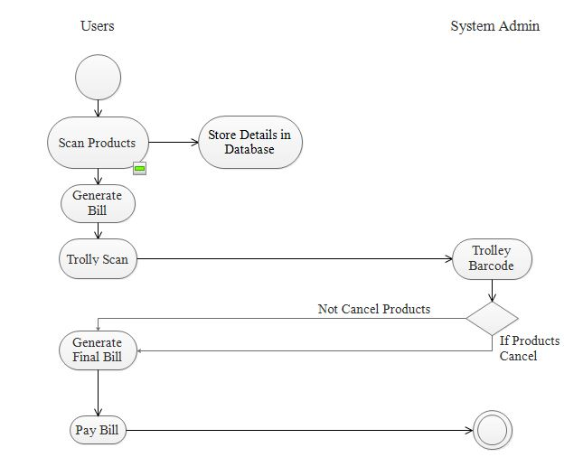
Activity Diagram :-

Slide 23
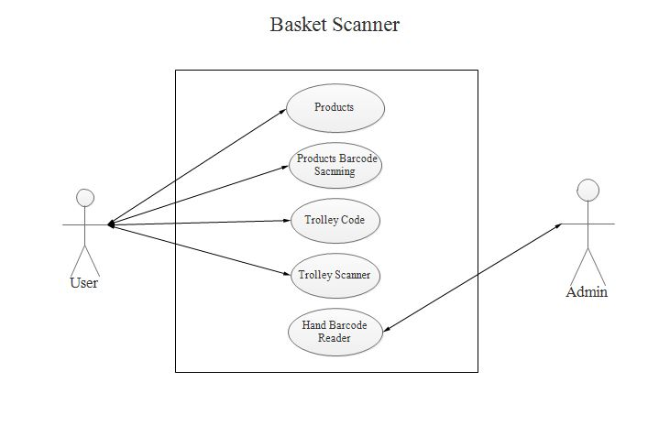
Uses case Diagram :-

Slide 24
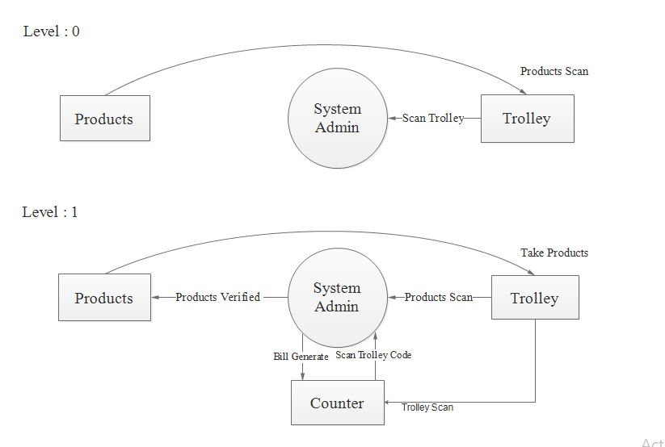
Data Flow Diagram :-

Slide 25
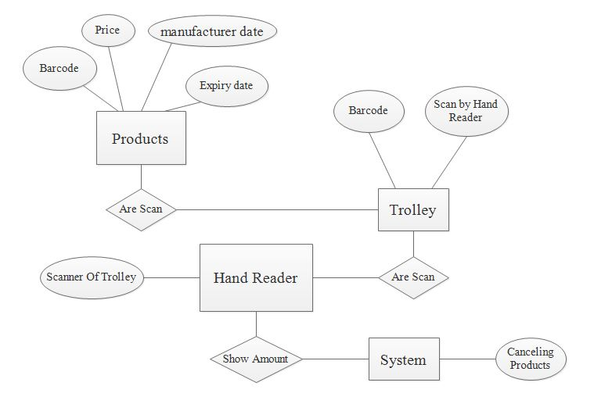
ER Diagram :-

Slide 26
Reference by:-
https://www.instructables.com/id/How-to-make-your-own-Arduino-board/
https://www.teachmemicro.com/intro-nodemcu-arduino/
https://www.instructables.com/id/RFID-Reader-Detector-and-Tilt-Sensitive-RFID-Tag/
https://electronut.in/an-iot-project-with-esp8266/
https://www.electronics-tutorials.ws/combination/comb_2
https://circuitdigest.com/
http://www.academia.edu/5593637/RFID_Based_Shopping_Trolley_Project_Report
https://www.arduino.cc/

Slide 27
Thank You

